Slide 1

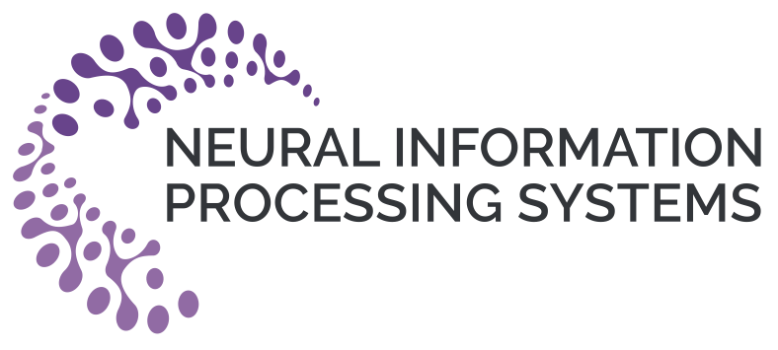
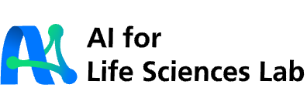

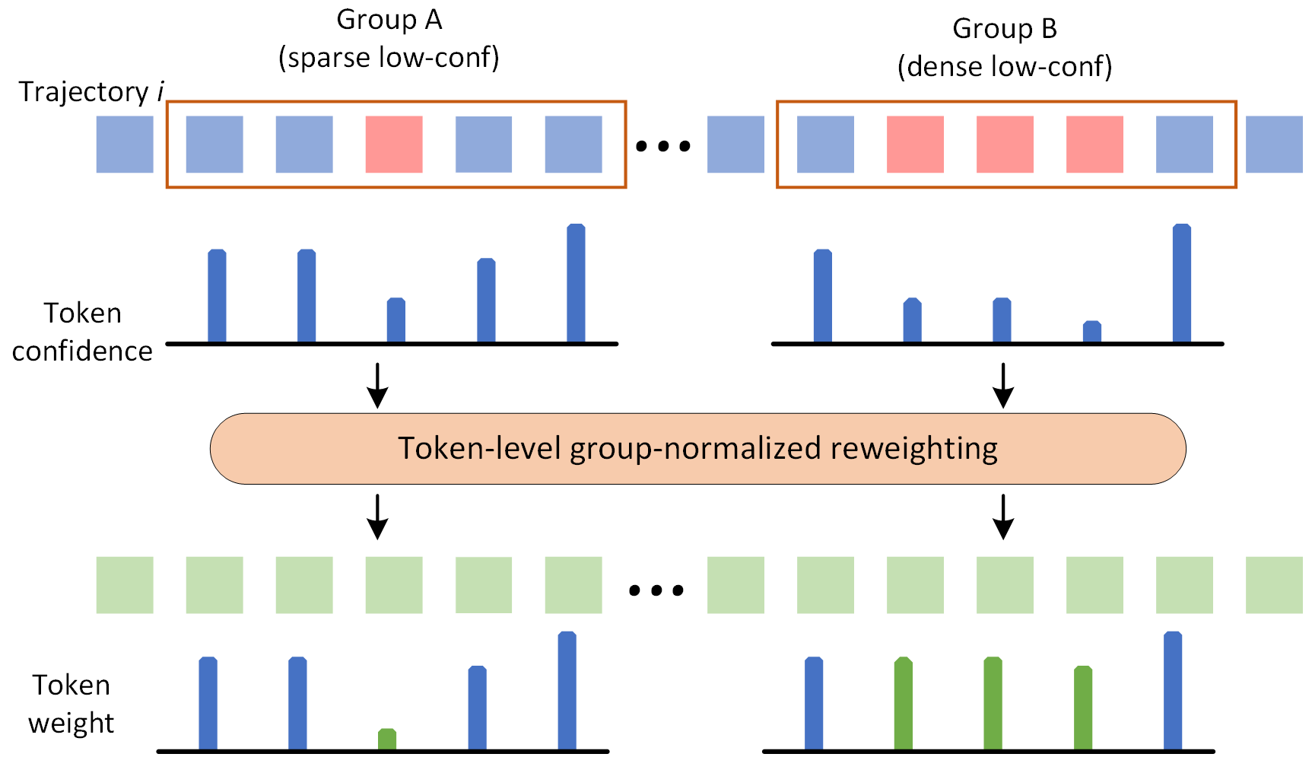
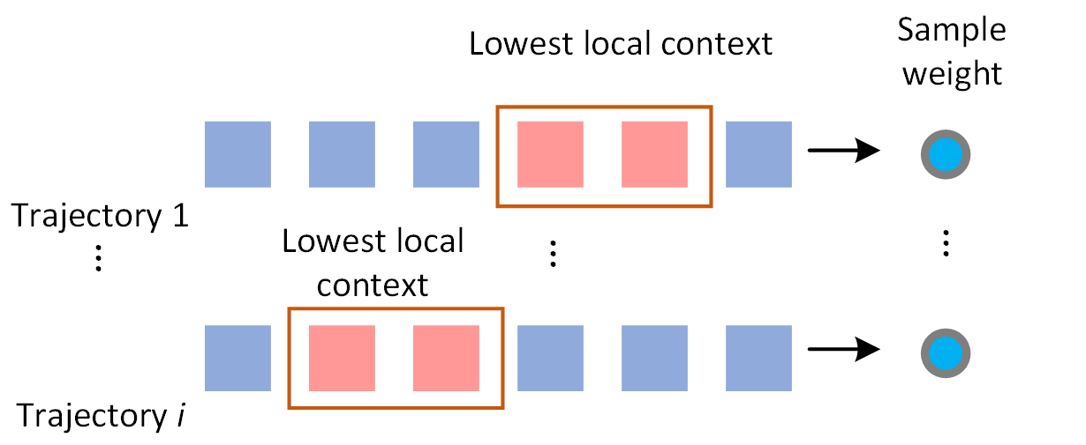
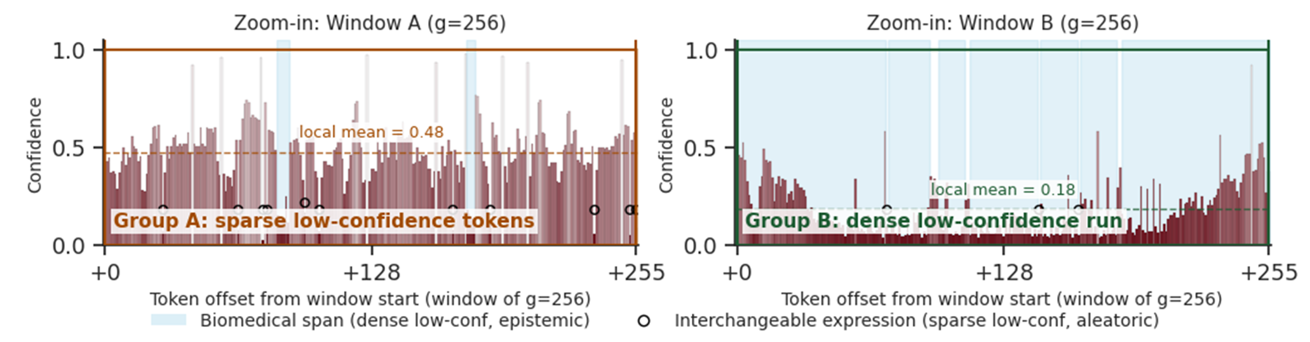
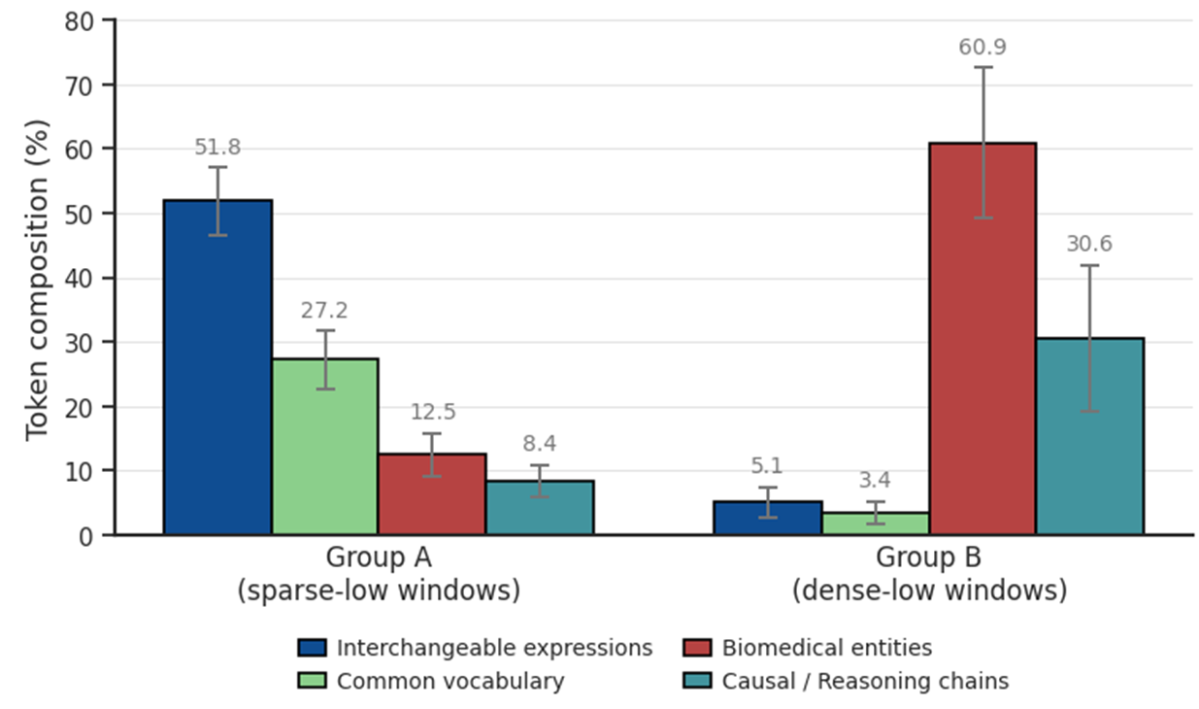
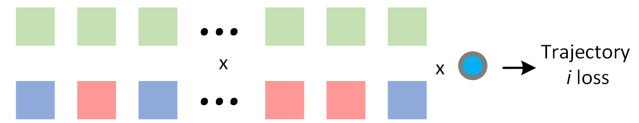
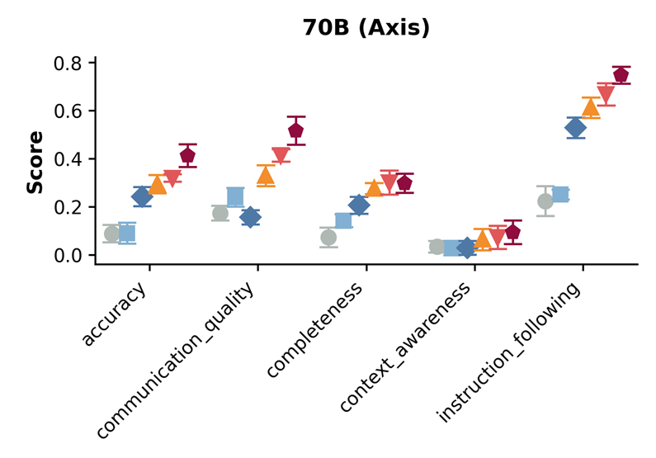
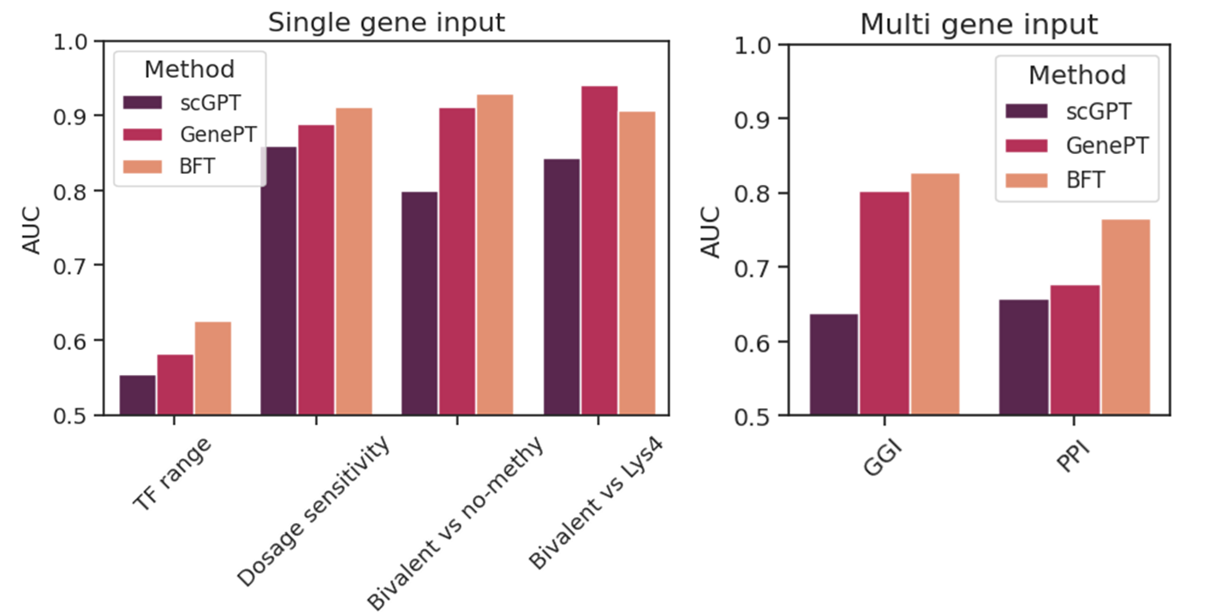
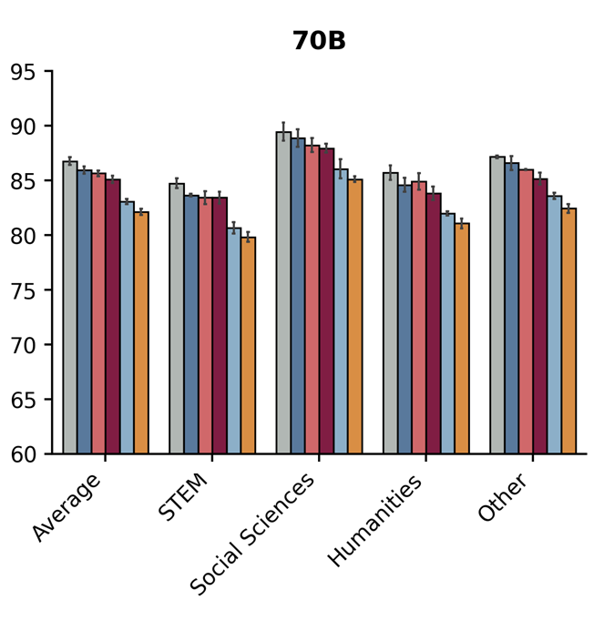
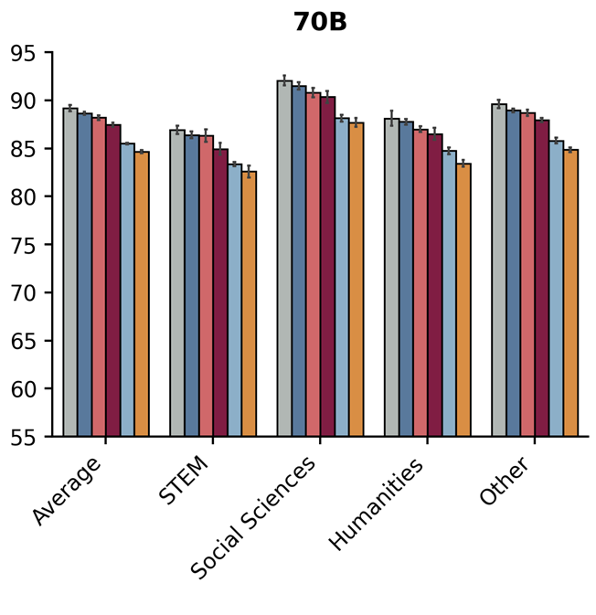
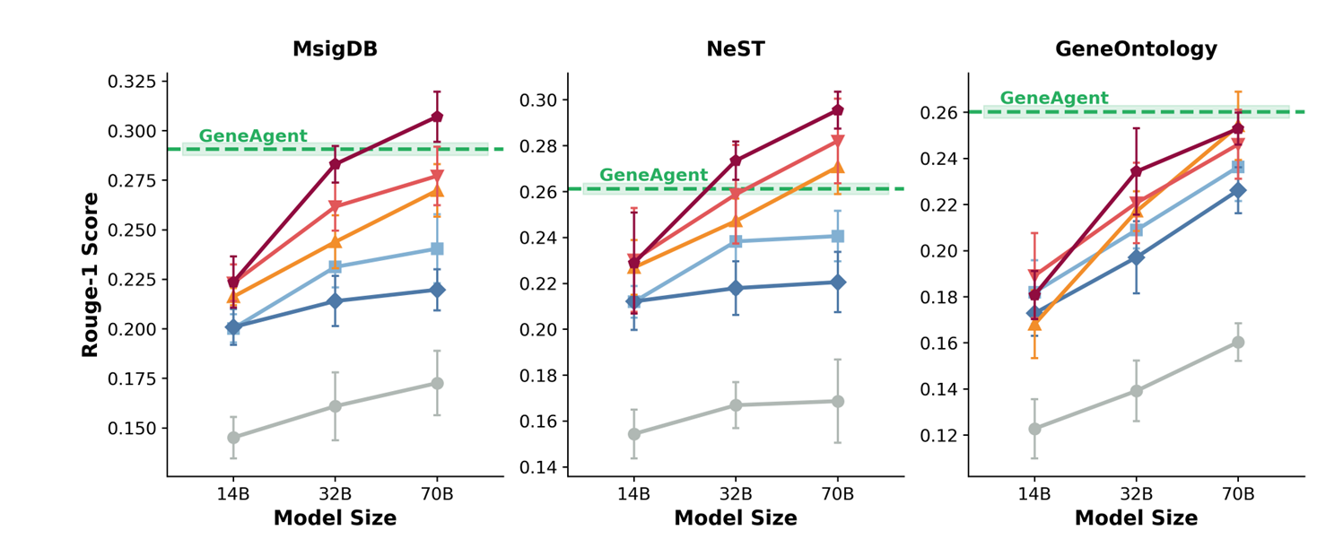
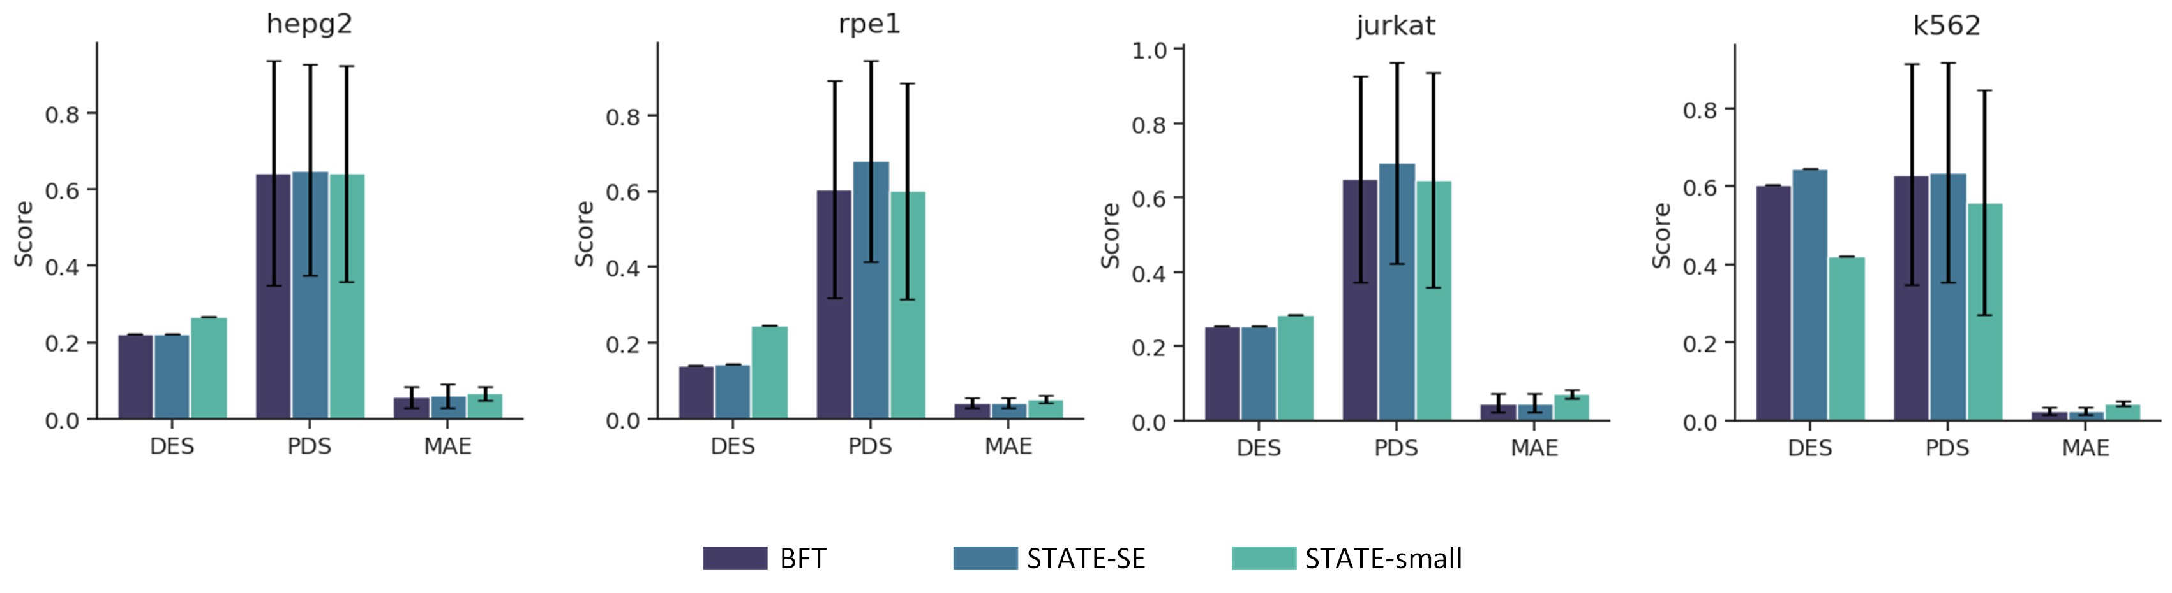

Aligning LLMs with Biomedical Knowledge
using Balanced Fine-Tuning
Zhenchao Tang*¹, Fang Wang*†¹, Haohuai He¹, Jiale Zhou¹, Tianxu Lv¹, Jun Zhu¹, Shouzhi Chen¹, Minghao Yang¹,
NeurIPS 2026
arxiv.org/abs/2511.21075
shapsider.github.io/BFT
Yu Wang¹, Jiayang Wu¹, Yidong Song², Yaokun Li³, Jiehui Huang⁴, Jun Zhou⁵, Bing He¹, Jianhua Yao†¹
¹Tencent AI for Life Sciences Lab ²Nankai University ³Sun Yat-sen University ⁴HKUST ⁵Tsinghua University
*Equal contribution †Correspondence: avonwanghit@gmail.com, jianhua.yao@gmail.com
1 Challenge: useful knowledge is difficult
3 Method: Balanced Fine-Tuning
Confidence-based training can suppress unfamiliar biomedical words. An isolated difficult word and a whole difficult passage need different treatment.
1 Keep useful words in difficult passages
2 Prioritize examples with hard passages
2 Motivation: learn difficult passages
Grouped difficult passages contain more biomedical entities (60.9% vs 12.5%) and reasoning content (30.6% vs 8.4%).
3 Combine both signals during training
Preserve useful difficulty while retaining broad knowledge.
These associations motivate BFT. They do not identify every uncertain word as useful knowledge.
Use the model’s own confidence; cap example weights. No reward model or external uncertainty estimator.
4 Experimental results: biomedical gains with less general forgetting
Stronger biomedical reasoning
Preserving general capability
Useful scientific representations
HealthBench Hard (70B): medical competence across five evaluation dimensions.
MMLU and CMMLU (70B): BFT preserves more general knowledge than SFT while improving biomedical skills.
Gene descriptions become inputs for gene prediction and single-cell response modeling.
MMLU
CMMLU
Biological process reasoning
Mean gene score: BFT 0.829 vs GenePT 0.802. GenePT remains higher on Lys4. Both use the same text encoder.
Both benchmarks show less forgetting than SFT and sample-only BFT. Some forgetting remains. DFT forgets least, while BFT offers stronger biomedical adaptation.
STEM adaptation demonstrated in biomedicine.
Comparable STATE results across four datasets. Profile generation is zero-shot here; the STATE model is still trained.
Notes:
Edited from author-selected BFT-NeurIPS2026-Plain-Language-Final-R2.pptx. All scientific visuals are unchanged-pixel crops from supplied camera-ready Figure1-5. Crop boxes and masks of letter-only margins are recorded in .build/poster-paper-figures/crop-manifest.json. Challenge uses Figure1b, motivation Figure1a, method Figure1c split into three original-pixel crops (token, sample, combination), see method-crop-manifest.json, biomedical results Figure2a/b; HealthBench retains complete original category labels, general retention original 70B MMLU and CMMLU panels from Figure3a. The original shared category-label strip is duplicated under MMLU so each panel has complete names. Original legend entries are rearranged in two rows without redrawing, gene representation Figure4b, single-cell response Figure5. No reconstructed chart, diagram, or evidence table. Native text explains token as word for a broad audience. Main paper Section3 and Results provide scientific claims. General ability is retained better than SFT, not without loss, and DFT forgets least. STEM extension is demonstrated specifically in medicine and biology, not tested across all STEM fields. Gene mean AUC 0.829 vs GenePT0.802, with Lys4 exception. Same text encoder but different profile source. Only profile generation is zero-shot on perturbation datasets. Source: https://arxiv.org/abs/2511.21075 and supplied neurips_2026_arxiv.tex. Logos and original master retained. No displayed equations added.

